Slide 1
AWS Lambda
Tim Artz
July 2023
Notes:
Note the purpose of this presentation is that you will have the information you need to create a Lambda function in AWS and know how to execute it

Slide 2


Agenda
What is Lambda
Brief History
AWS to Azure Services Comparison
When to use Lambda
Key Features of Lambda
Execution Environment
Pricing
Best Practices
Lambda Demo
2

Slide 3
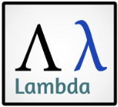

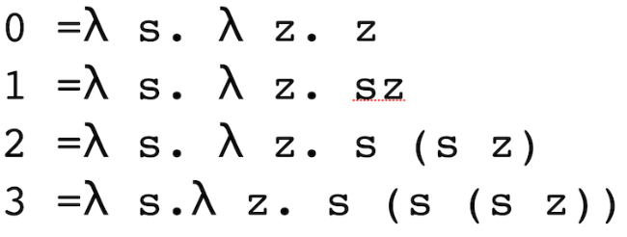
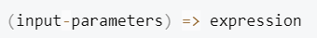
AWS Lambda?
11th Letter of Greek Alphabet
Alonzo Church invented lambda calculus
Anonymous Function
Notes:
Retrieve from Wikipedia
Alonzo Church Interesting fact – Alan Turing worked for him, who eventually helped in deciphering the Enigma Machine messages during WW2
Calculus pic is how you write 0 through 3 in lambda calculus
Anonymous Function is a function definition that is not bound to an identifier – Originates in the work of Lambda Calculus

Slide 4
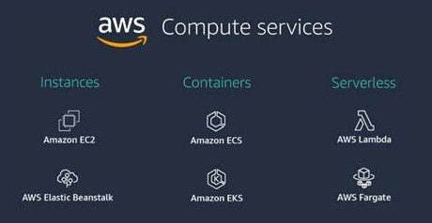
What is AWS Lambda
Serverless Compute Service
Code is triggered based on an AWS application or Partner Event Source.
What is AWS Lambda? - AWS Lambda (amazon.com)
Notes:
Serverless Computer
let's you run code without provisioning or managing servers.
Lambda runs your code on high-availability compute infrastructure
Amazon EC2 – Elastic Compute Cloud
AWS Fargate – serverless compute for containers
AWS Elastic Beanstalk – Service for deploying and scaling web applications and services

Slide 5
Brief History
2014
Launched in Preview
2015
Available to All AWS Customers
2016
Lambda Edge, Step Functions launched in Preview
2017
Memory capacity doubled to 3008 MB
2018
Increased flexibility with functions
2019
Provisioned Concurrency Introduced
Source: Follow the evolution of AWS Lambda | TechTarget
Notes:
2014
Functions were written in Node.js
Triggered by Amazon S3, Amazon Kinesis streams, or table updates in Amazon DynamoDB
Serverless
2015
Java supported
Triggered by SNS and API Gateway
2016
Edge executes the functions in AWS locations closer to the viewer
Serverless orchestration service, runs a group of Lambda functions in a specific order
C# supported
2017
Support for Code-Deploy
Addition of concurrency limits
2018
Executions times tripled to 15 minutes
Ruby and Golang supported
Triggered by Amazon SQS (simple queue service)
2019
Provisioned Concurrency allows functions to have consistent start-up latency. Allows them to serve a burst of traffic
Support added for asynchronous invocations

Slide 6
Brief History
2021
Lambda Extensions Support
2022
2023
2020
Container Image Support
Lambda SnapStart Support
Amazon DocumentDB Support
Amazon Inspector Support
AWS re:Invent 2020 – Top Announcements | AWS News Blog (amazon.com)
Top Announcements of AWS re:Invent 2021 | AWS News Blog (amazon.com)
Top Announcements of AWS re:Invent 2022 | AWS News Blog (amazon.com)
Notes:
2020
Support for container images, up to 10 GB in size
Base images provided: Python, Node.js, Java, .NET, Go, Ruby
2021
Extensions allow you to integrate your favorite operational tools for monitoring, observability, security, and governance
Support for Amazon RDS for PostgreSQL
Support for Amazon MQ for RabbitMQ
2022
SnapStart allows Java functions to start up to 10x faster at no extra cost
Amazon Inspector – vulnerability management service that scans workloads for software vulnerabilities and unintended network exposure
Also introduced tiered pricing
2023
Support for DocumentDB as event source (MongoDB-compatible document database))

Slide 7
AWS to Azure Services Comparison
Section | AWS | Azure
Serverless Computing | Lambda | Functions
Workflow | Step Functions | Logic Apps
Database | DynamoDB | Azure Cosmos DB
Web Application | API Gateway | API Management
Messaging and Eventing | Amazon Kinesis | Event Hubs
Messaging and Eventing | Simple Queue Service (SQS) | Queue Storage
Messaging and Eventing | Simple Notification Service (SNS) | Service Bus
Object Storage | Simple Storage Services (S3) | Blob Storage
Management | CloudWatch | Application Insights
Infrastructure as Code (IaC) | CloudFormation | Resource Manager
Security | Identity and Access Management (IAM) | Azure Active Directory Azure role-based access control
DevOps | CodeDeploy CodeCommit CodePipeline | DevOps
Notes:
Step Functions – Serverless orchestration service, runs a group of Lambda functions in a specific order
DynamoDB – Serverless NoSQL
Kinesis – Used to collect and process large streams of data records in real time
API Gateway – Create and deploy REST and WebSocket APIs
CloudWatch Monitors AWS resources in real time. Collects and track metrics
IAC - TerraForm

Slide 8
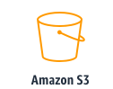
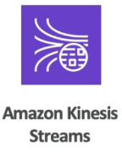
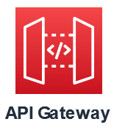


When to use Lambda
Applications that need to scale up rapidly and scale down to zero when not in demand
File Processing
Stream Processing
Web Applications
IoT Backends
Mobile Backends
Common Lambda application types and use cases - AWS Lambda (amazon.com)
Notes:
File Processing: Amazon S3 (Simple Storage Service) can be used to trigger Lambda data processing in real time after an upload
Stream Processing: Use Amazon Kinesis to process real-time streaming data for application activity tracking, transaction order processing, and clickstream analysis
Web Applications: Build web applications that automatically scale up and down that run in multiple data centers
IoT Backends: Handle web, mobile, IoT, and third-party requests (AWS IoT – services and solutions to connect and manage devices)
Mobile Backends: Process API requests from iOS, Android, React native frontends (AWS Amplify – Enables frontend web and mobile developers to build full stack applications on AWS)

Slide 9

Key Features
Configuring Function Options
Environment Variables
Versions
Container Images
Layers
Lambda Extensions
Function URLs
Response Streaming
Concurrency and Scaling Controls
Code Signing
Private Networking
Database Access and Proxy
File System Access
Lambda SnapStart for Java
What is AWS Lambda? - AWS Lambda (amazon.com)
Notes:
Configure Options – Configure using console or AWS CLI
Environment Variables – Adjust your functions behavior without updating code
Versions – A new function can be used for beta testing without affecting production
Container images – Use AWS provided base images or alternative base image to reuse your existing container tooling
Layers – Package libraries and other dependencies to reduce the size of deployment archives to faster deploy code
Lambda Extensions – Augment your functions with tools for monitoring, security and governance
Function URLs – Add dedicated HTTP(S) endpoint to your Lambda function
Response Streaming – Configure Lambda function URLs to stream response payloads back to clients from Node.js functions
Concurrency and Scaling controls – Apply control over scaling and responsiveness of production applications
Code Signing – Verify that only approved developers publish code to your lambda functions
Private Networking – Create private network for resources such as databases, cache instances, or internal services
Database access and proxy – Create an Amazon RDS database proxy to manage a pool of database connections
File system access – Create a function to mount an Amazon Elastic File System to a local directory so the function can access and modify shared resources
Lambda SnapStart for Java – Improved startup performance for Java runtimes by up to 10x at no extra cost

Slide 10
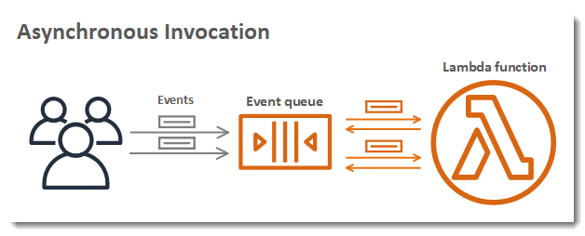
Additional Features
Asynchronous Invocation
Lambda retries asynchronous calls if the function returns an error or is throttled
Can configure Lambda to send events that failed to a dead-letter queue
Additional Lambda features - AWS Lambda (amazon.com)

Slide 11
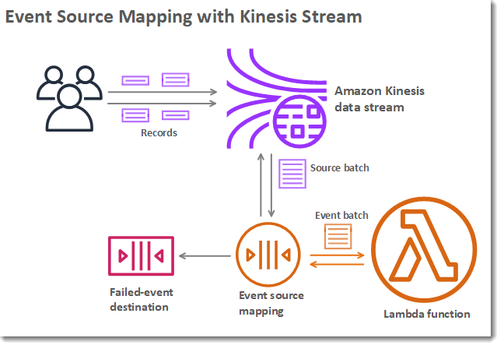
Additional Features
Event Source Mappings
Process items in batches from a stream or queue
Amazon SQS
Amazon Kinesis stream
Amazon DynamoDB stream
Events can contain thousands of items
Additional Lambda features - AWS Lambda (amazon.com)

Slide 12
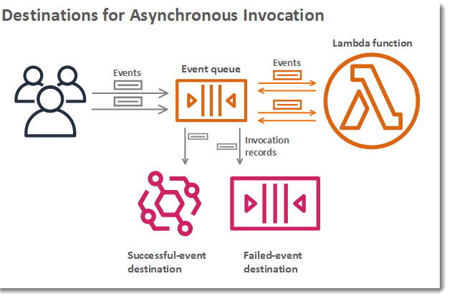
Additional Features
Destinations
For Asynchronous Invocation, send records to:
Queue
Topic
Function
Event Bus
Separate destinations can be configured for success and failed processing
Additional Lambda features - AWS Lambda (amazon.com)
Notes:
Definition of Destination – AN AWS resource that receives invocation records for a function

Slide 13

Additional Features
Function Blueprints (Templates)
Three Ways to Create Function
Scratch
Blueprint
Provides sample code for an AWS service or third-party application
Container Image
Additional Lambda features - AWS Lambda (amazon.com)

Slide 14
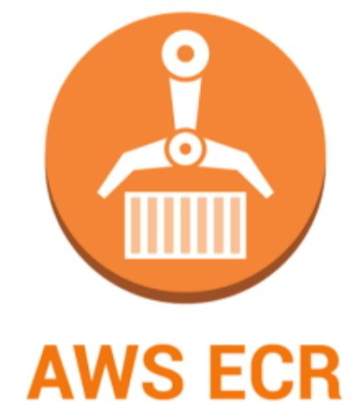
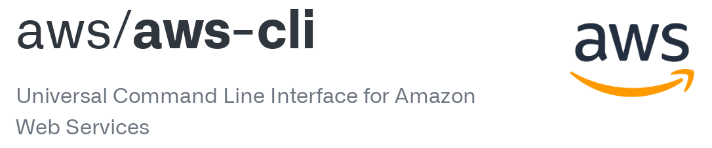
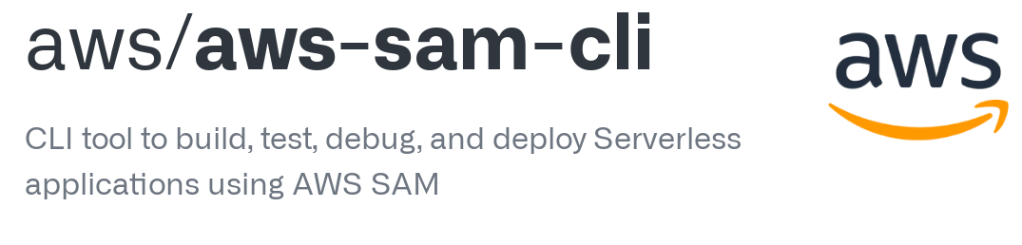
Additional Features
Testing and Deployment Tools
Deploy code
As Is
Container Images
Command Line tools
AWS CLI
AWS SAM CLI
Additional Lambda features - AWS Lambda (amazon.com)
Notes:
Container Images - AWS ECR (Elastic Container Registry) – Container Image registry service
AWS CLI
Allows interaction with AWS services using command line shell
Bash, zsh, and tcsh can be used for Linux.
Window command prompt or Powershell in Windows
Remotely on Amazon EC2 (Elastic Compute Cloud) through PuTTY or SSH or AWS systems Manager\
AWS SAM CLI
AWS SAM (Serverless Application Model) – Toolkit for improving developer experience of building and running serverless applications using templates (AWS Cloud Formation) and the CLI
Used for developing, testing, and deploying serverless applications to the cloud
Also works with Terraform

Slide 15
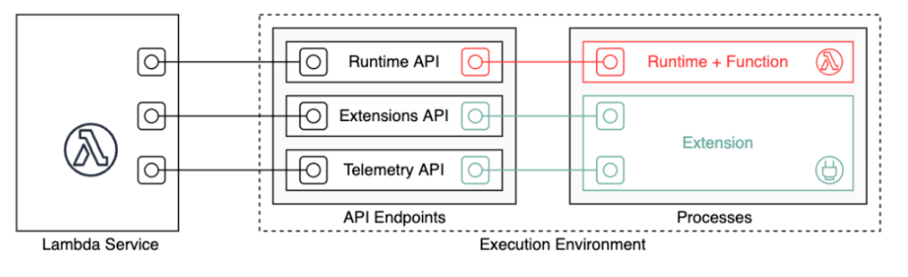
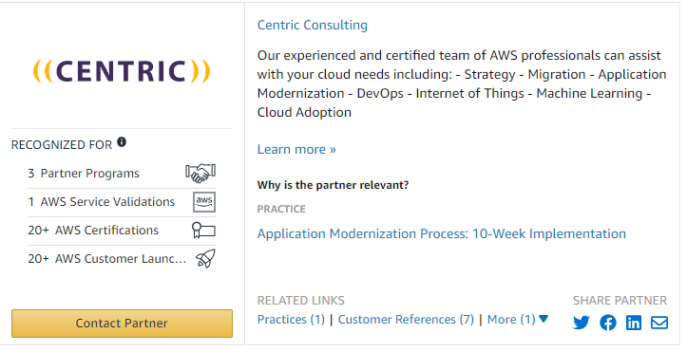
Execution Environment
Runtime API – HTTP API for custom runtimes
Extensions API – Integrate Lambda functions with preferred monitoring tools
Telemetry API – Receive telemetry data from Lambda functions
Execution Environment - AWS Lambda (amazon.com)
Notes:
Runtime API – Receive invocation events from Lambda and send response data back
Extensions API – Favorite tool extensions from companies like
Data Dog, Splunk, HashiCorp, F5, Okta, and Centric Consulting
Telemetry API – Captures logs, platform metrics, and platform traces in near real time
Three different telemetry streams:
1. Platform telemetry – Logs, metrics, and traces describing events and errors related to execution environment runtime
2. Function Logs – Custom logs that Lambda function code generates
3. Extension logs – Custom logs that Lambda extension code generates

Slide 16
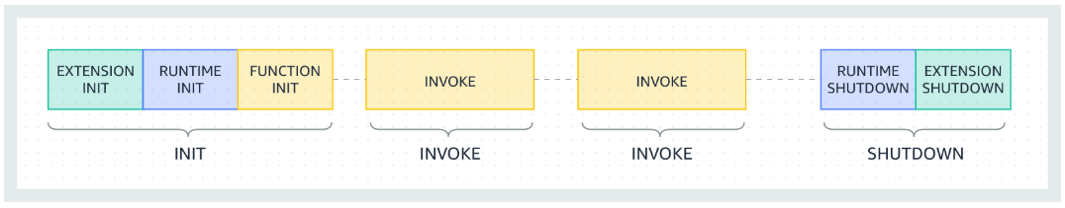
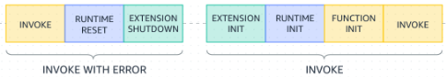
Execution Environment Lifecycle
Failure Process during Invoke Phase
Execution Environment - AWS Lambda (amazon.com)
Notes:
Init Phase
Start all extensions
Bootstrap the runtime
Run the functions static code
Run any “beforeCheckpoint” runtime hooks (Lambda SnapStart only – For java code)
Restore Phase (NOT SHOWN in PIC above)
Used by Lambda SnapStart only
Lambda resumes new execution environments from the persisted snapshot instead of initializing the function from scratch
Invoke Phase
When Lambda function is invoked, Lambda sends an Invoke event to the runtime and to each extension
The Timeout setting limits the duration of the entire Invoke phase
IF SOMEONE ASKS: if you set the function timeout as 360 seconds, the function and all extensions need to complete within 360 seconds
Invoke Phase with Error
When invoke failure occurs
Lambda service performs a reset (reset behaves like a Shutdown event)
Shuts down runtime
Sends Shutdown event to each external extension (includes reason for the shutdown)
Reinitializes the extension and runtime together
Invoke phase after “Invoke with Error” – represents INVOKE phase immediately following an invoke failure
Shutdown Phase
When Lambda is about to shutdown the runtime
It sends a Shutdown event to each registered external extension
Entire shutdown phase is capped at 2 seconds

Slide 17


Pricing
Charged based on the number of requests and the duration of execution
How are requests counted?
Each time execution starts in response to an event trigger
Includes test invokes from AWS console
How is duration calculated?
Time it starts executing until it returns or terminates
Rounded up to the nearest 1 ms
Duration charges apply to code:
Handler in a function
Initialization Code that is declared outside of the handler
Time it takes for code in the last running extension to finish during shutdown phase
Price depends on amount of memory is allocated to your function
Serverless Computing – AWS Lambda Pricing – Amazon Web Services

Slide 18

Pricing
Free Tier
Includes 1 million free requests per month and 400,000 GB-seconds of compute time per month
Usable for functions powered by x86 and Graviton2 processors
Includes 100GiB of HTTP response streaming per month, beyond the first 6MB per request, which are free
Serverless Computing – AWS Lambda Pricing – Amazon Web Services

Slide 19
Pricing
Pricing is based on Region. Below chart is for US East (Ohio)
Architecture | *Duration | Requests
x86 Price
First 6 Billion GB-seconds / month | $0.0000166667 for every GB-second | $0.20 per 1M requests
Next 9 Billion GB-seconds / month | $0.000015 for every GB-second | $0.20 per 1M requests
Over 15 Billion GB-seconds / month | $0.0000133334 for every GB-second | $0.20 per 1M requests
Arm Price
First 7.5 Billion GB-seconds / month | $0.0000133334 for every GB-second | $0.20 per 1M requests
Next 11.25 Billion GB-seconds / month | $0.0000120001 for every GB-second | $0.20 per 1M requests
Over 18.75 Billion GB-seconds / month | $0.0000106667 for every GB-second | $0.20 per 1M requests
*Duration cost depends on the amount of memory allocated to your function
Good article on Lambda Pricing: AWS Lambda Pricing: A Complete Guide (awsfundamentals.com)
Serverless Computing – AWS Lambda Pricing – Amazon Web Services
Notes:
Using ARM architecture can make a great difference. It’s 34% more price efficient compared to the x86 architecture

Slide 20

Best Practices (Partial List, see full list using link below)
Function Code
Initialize SDK clients and database connections outside of function handler
Saves Cost by reduce function run time
Use a keep-alive directive to maintain persistent connections
Lambda purges idle connections over time
Reduce the time it takes Lambda to unpack deployment packages
Put dependency jar files in separate /lib directory instead of in a single jar with high number of .class files
Minimize complexity of your dependencies
Prefer simpler frameworks that load quickly on execution environment startup
Avoid using recursive code
This could lead to unintended volume of function invocations and escalated costs
Best practices for working with AWS Lambda functions - AWS Lambda (amazon.com)
Notes:
This is a partial list. The link at the bottom shows best practices for function code, function configuration, metrics and alarms, working with streams, and security best practices

Slide 21
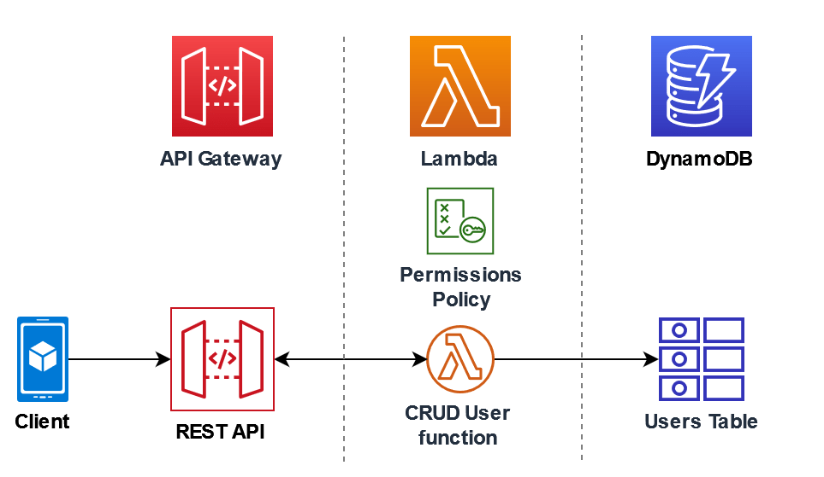
Demo
Will create a REST API which will invoke a Lambda function using an HTTP request. The Lambda function will perform CRUD operations on a DynamoDB table.

Slide 22
Demo
Steps for this demo
1. Review Created Policy | 6. Review DynamoDB table
2. Review Created Role | 7. Integration Test
3. Create the function | 8. Deploy the API
4. Invoke the function using the AWS CLI | 9. Use Postman to invoke your function using HTTP requests
5. Create API Gateway

Slide 23
Demo
Prerequisites
AWS account (must have administrative capabilities)
AWS CLI
.NET Core Global Tool installed
Will be used to deploy function to AWS
To install using command line: dotnet tool install –g Amazon.Lambda.Tools
Tools Used
Visual Studio Code
Notes:
AWS Account
Anyone can use AWS site for learning AWS. You have to reach out to CentricIT in order to get access to the site
Centric National will pay for any charges under $200 a month, anything over $200 then entire amount is charged to BU
Also need to have administrative access in order to create the policy and roles

Slide 24
Demo
Review Created Policy
{
"Version": "2012-10-17",
"Statement": [
{
"Sid": "Stmt1428341300017",
"Action": [
"dynamodb:DeleteItem",
"dynamodb:GetItem",
"dynamodb:PutItem",
"dynamodb:Query",
"dynamodb:Scan",
"dynamodb:UpdateItem"
],
"Effect": "Allow",
"Resource": "*"
},
{
"Sid": "",
"Resource": "*",
"Action": [
"logs:CreateLogGroup",
"logs:CreateLogStream",
"logs:PutLogEvents"
],
"Effect": "Allow"
}
]
}
Notes:
Permission policy will give the Lambda function to perform CRUD operations on a DynamoDB table and to write to CloudWatch logs.
Steps.
Go to IAM Console
Open Policies page
Select “Lambda-apigateway-policy”
Show the permissions in list. Can also view in JSON

Slide 25
Demo
Review Created Role
NOTE: ARN (Amazon Resource Name)
arn:aws:iam::689602237863:role/lambda-apigateway-role
This will be used when we create the Lambda function
Notes:
Execution role grants the Lambda function permission to access AWS services and resources that we defined in the policy
Steps.
Open Roles page
Type lambda in Search
Select lambda-apitgateway-role
Note reference to policy
ARN is at top right of screen

Slide 26
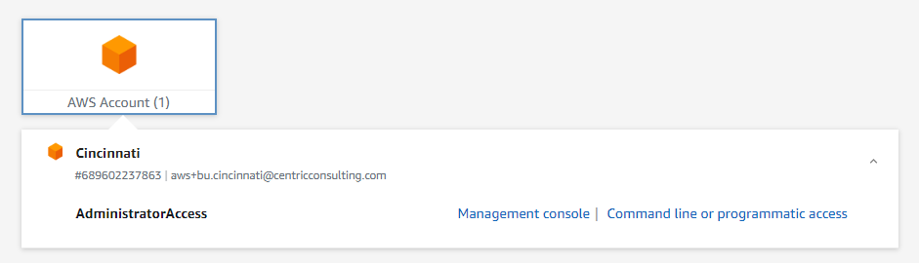
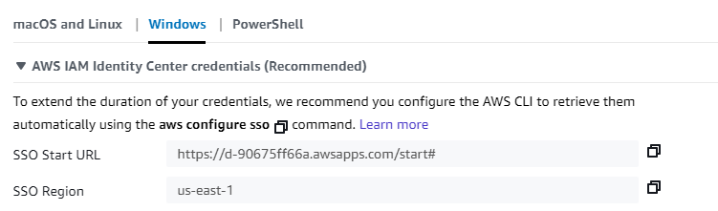
Demo
Create Function
In order to communicate with AWS from command line, you’ll need to setup SSO.
using Centric AWS (click “Command line or programmatic access” below
Once select then select OS and follow instructions

Slide 27
Demo
Create Function
Create an empty Lambda function
dotnet new lambda.EmptyFunction --name LambdaApiGateway --profile Centric --region us-east-2
aws lambda create-function -–function-name LambdaFunctionOverHttps --runtime dotnet6 –role arn:aws:iam::689602237863:role/lambda-apigateway-role
Add packages
dotnet add package AWSSDK.DynamoDBv2 --version 3.7.104
dotnet add package Amazon.Lambda.APIGatewayEvents --version 2.6.0
dotnet add package AWSXRayRecorder --version 2.14.0
When publishing to AWS Site
aws sso login –profile centric
dotnet build src/LambdaApiGateway
dotnet lambda deploy-function LambdaFunctionOverHttps --profile Centric –region us-east-2 -pl src/LambdaApiGateway -frole lambda-apigateway-role
Test from CLI
aws lambda invoke --function-name LambdaFunctionOverHttps --payload file://src/LambdaApiGateway/input.txt outputfile.txt --cli-binary-format raw-in-base64-out --region us-east-2 --profile Centric
Notes:
Switch to Visual Studio Code
Show Code layout
Show AWS Extension
Show aws-lambda-tools-defaults.json
Point out profile, region, and function-handler
Show Lambda in VSC AWS list and Console
RUN dotnet build command
RUN dotnet deploy command
Show in window and console
RUN test CLI command

Slide 28
Demo
Review DynamoDB Table
DynamoDB is AWS Serverless NoSQL database
Table name is lambda-apigateway
Partition Key is ID and it is a string
No Indexes are used for this demo
Notes:
Items To Note:
Can turn on Point in Time Recovery which will backup table automatically so you can restore to any point in time in the preceding 35 days (additional charges apply)
Click Explore Items to show no items are in the table

Slide 29
Demo
Create REST Api
Notes:
Go to API Gateway
Page Down to REST API and click BUILD
Under “Create new API” click “New API”
Under Settings for API Name enter DynamoDBOpertions
Will Use Regional since it will only be used in the US-East-2 region
Click Create API
Under Actions click “Create Resource”
For Resource Name enter “DynamoDBManager”
Click “Create Resource”
Click “Create Method”
Select “POST”
Hit Check Mark
Make sure Lambda Function is selected
Lambda Region is us-east-2
Lambda Function “LambdaFunctionOverHttps”
For this example, only one POST method and Lambda function will be used but best practice is to use a different Lambda function and HTTP method for each operation.

Slide 30
Demo
Test REST API
Will test creating a record in the table by using following JSON in the body:
{
"operation": "create",
"payload": {
"Item": {
"id": {
"S": "1234ABCD"
},
"trainingtimes": {
"N": "5"
}
}
}
}
Notes:
Once completed show item in DynamoDB table. NOTE: Be sure to click lambda-gateway entry under table

Slide 31
Demo
Deploy REST Api
A REST Api must be deployed and staged in order to be called by a client
Once the API is staged you use the URL
Any logging defined in Lambda function will be written to CloudWatch
Notes:
A stage represents a snapshot of your API including its methods and integrations
Put call in Postman and show calls
For CloudWatch, go to CloudWatch and then click LogGroups and then the Lambda function under LogGroups
Steps:
Click Actions and then click “Deploy API”
Select New Stage
Select “Test” for Stage Name
Click Deploy
Copy Link and paste in Postman and then put “/dynamodbmanager” after /test

Slide 32
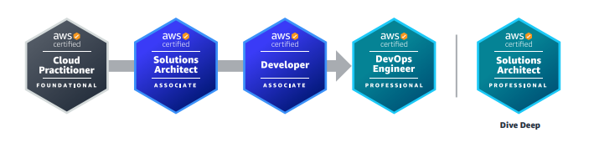
Further Training
Go to AWS Lambda Developer Guide to find further training
Using AWS Lambda with Alexa - AWS Lambda (amazon.com)
For Certification Interest:
AWS_certification_paths.pdf (awsstatic.com)
Notes:
For training, even if in different language go ahead and try to switch to the language you want to do it in: Good way to learn
Path shown is for Application Architect

Slide 33
Links
Tutorial for Demo can be found here
Tutorial: Using Lambda with API Gateway - AWS Lambda (amazon.com)
Getting Started Guide for using Lambda
Getting started with Lambda - AWS Lambda (amazon.com)
Installing the AWS CLI
Install or update the latest version of the AWS CLI - AWS Command Line Interface (amazon.com)
Installing Global Tools
.NET Core Global Tools for AWS | AWS Developer Tools Blog (amazon.com)

Slide 34
Links
AWS SDK for .NET
AWS SDK for .NET V3 API Documentation (amazon.com)
AWS SDK
AWS SDKs and Tools Reference Guide - AWS SDKs and Tools (amazon.com)
AWS CLI Command Reference
AWS CLI Command Reference — AWS CLI 1.29.10 Command Reference (amazon.com)

